Slide 1

A World Away: Hunting for Exoplanets with AI
2025 NASA Space Apps Challenge
https://deepskydivers.us
By:
Sanjana Vishwanatha
Nagarjun TS

Slide 2
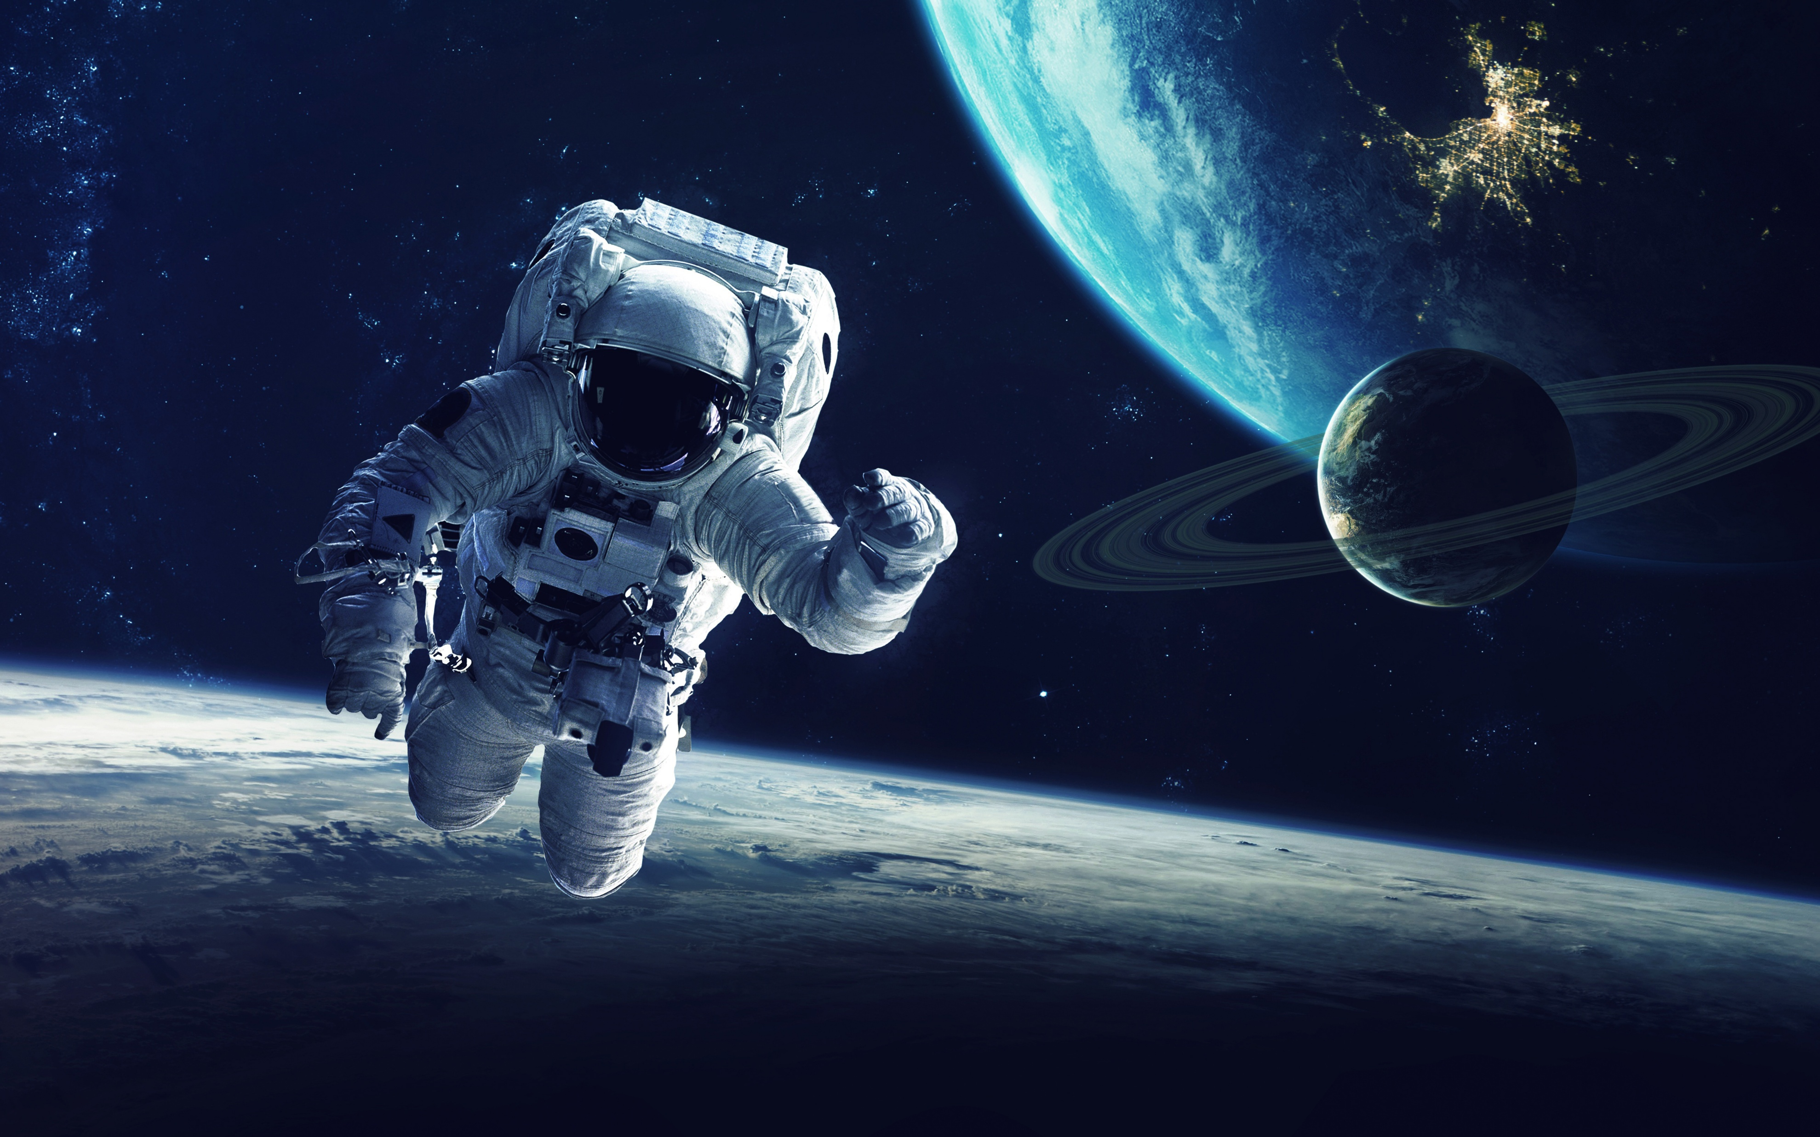
Agenda
Objective
Exoplanet Brief Explanation
Our Approach
Data Cleaning & Preprocessing
Machine Learning Model
Demo App
Challenges We Faced
References / Articles
Future Work/ Conclusion

Slide 3
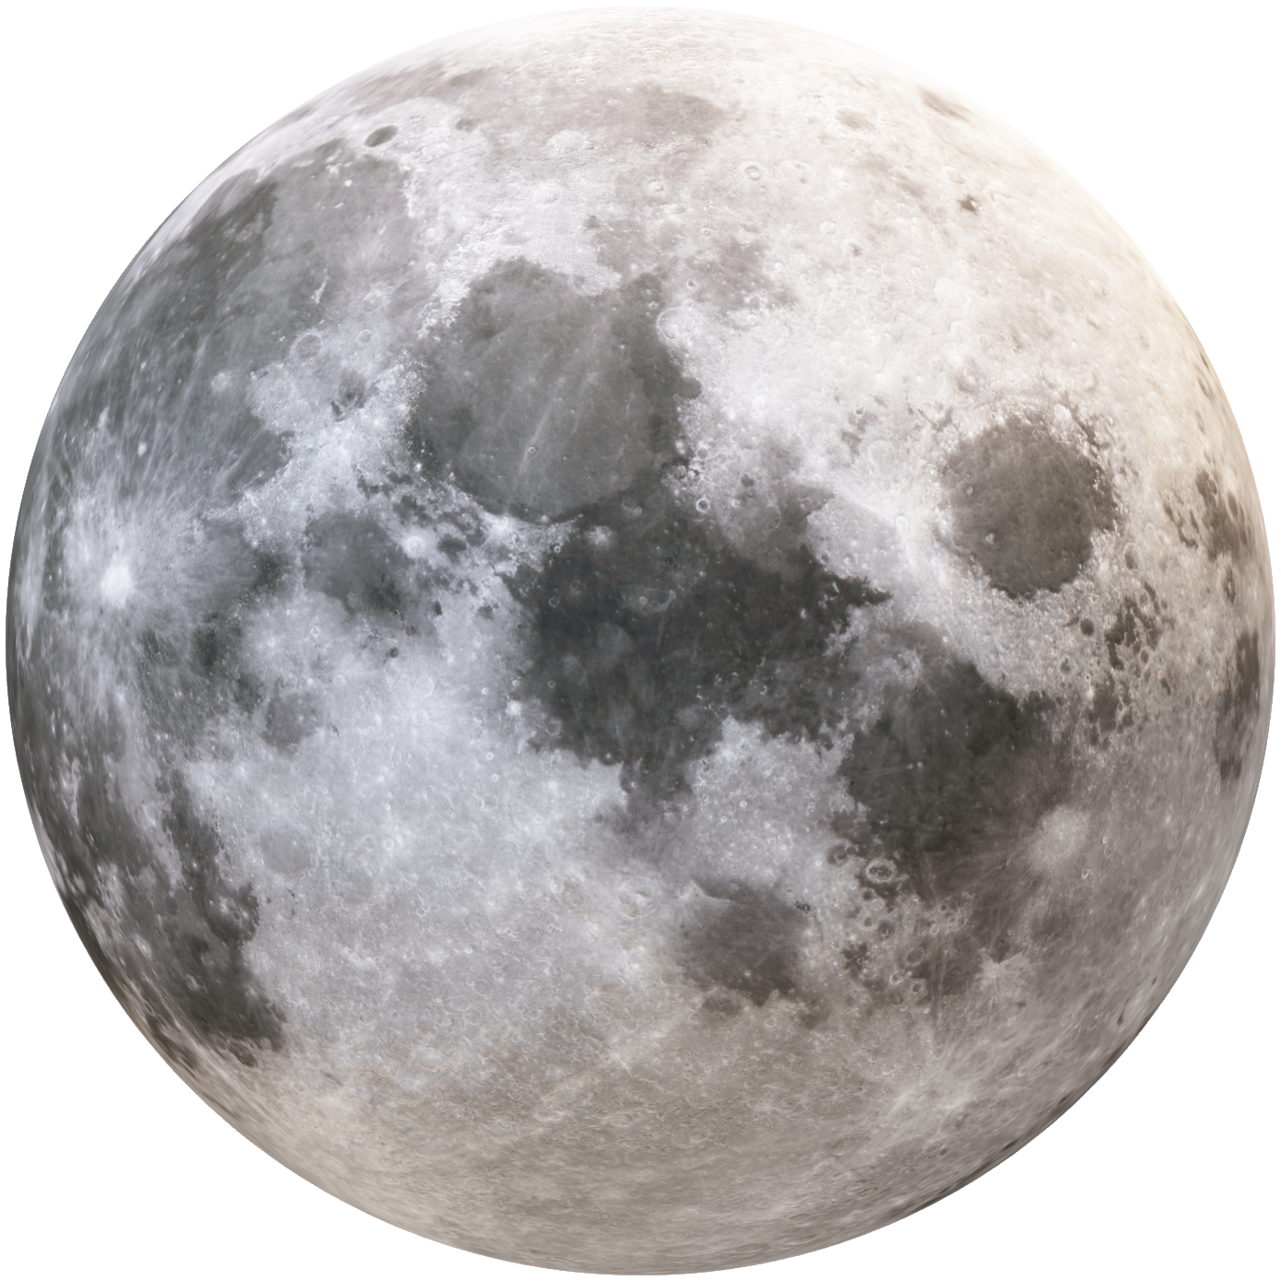
Objective
To automate the identification of exoplanets using AI and machine learning.
Build a robust pipeline from analyzing the raw data to predictions.
Provide an easy-to-use web app for scientists and enthusiasts.

Slide 4
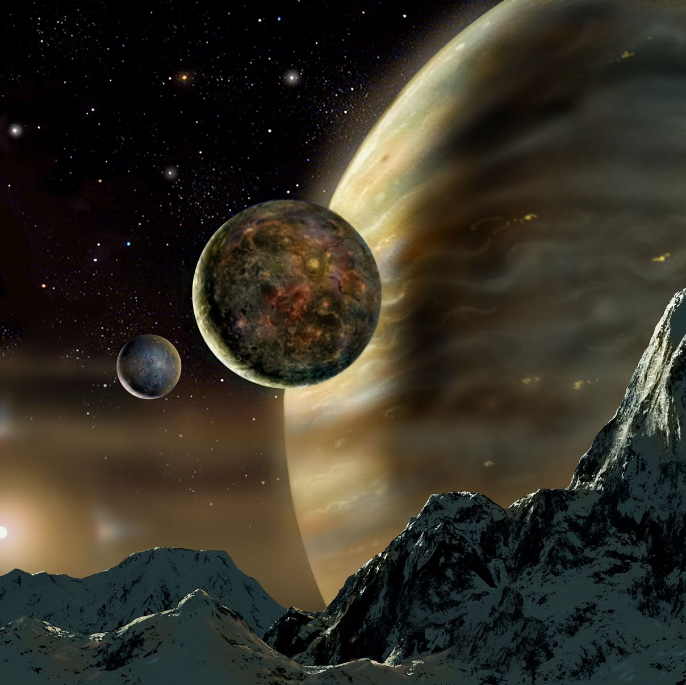
What is Exoplanet ?
An exoplanet or extrasolar planet is a planet outside of the Solar System
Objects with true masses below the limiting mass for thermonuclear fusion of deuterium that orbit stars or stellar remnants are "planets".
The minimum mass/size required for an extrasolar object to be considered a planet should be the same as that used in the Solar System.
There are many methods of detecting exoplanets. Transit photometry and Doppler spectroscopy have found the most.

Slide 5
Our Approach.. !
Utilized publicly available exoplanet datasets from NASA missions (Kepler & TESS).
Brainstorming all available columns in the NASA datasets (dropped irrelevant or redundant features, e.g., unique IDs, post-prediction labels)
Evaluated several machine learning algorithms.
Chose Random Forest Classifier for its robustness, interpretability, and strong performance on Classification data.
Continuously refined feature selection and preprocessing steps based on model performance.
Validated results using accuracy, precision, and recall metrics.
Developed a user-friendly web application for both single and batch predictions.

Slide 6
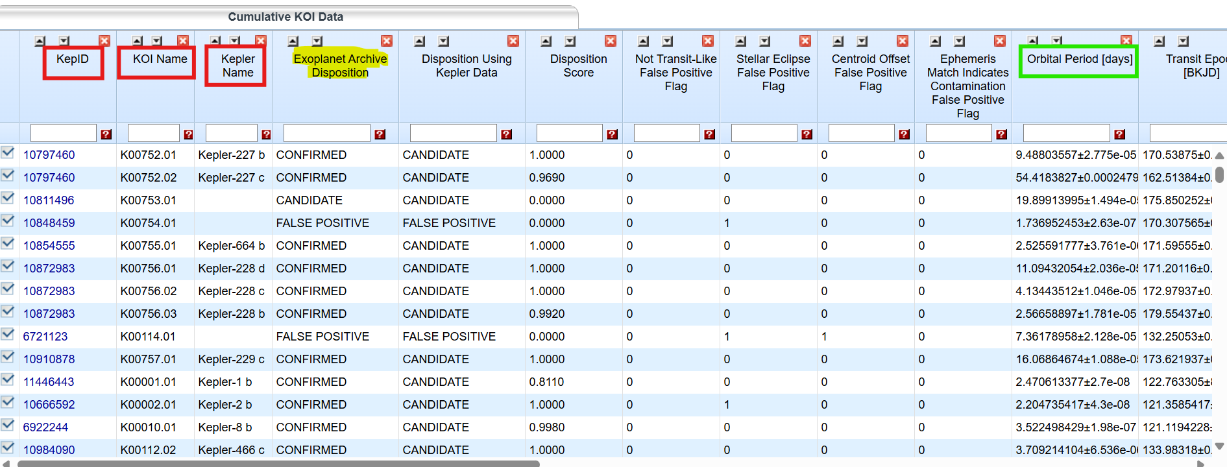

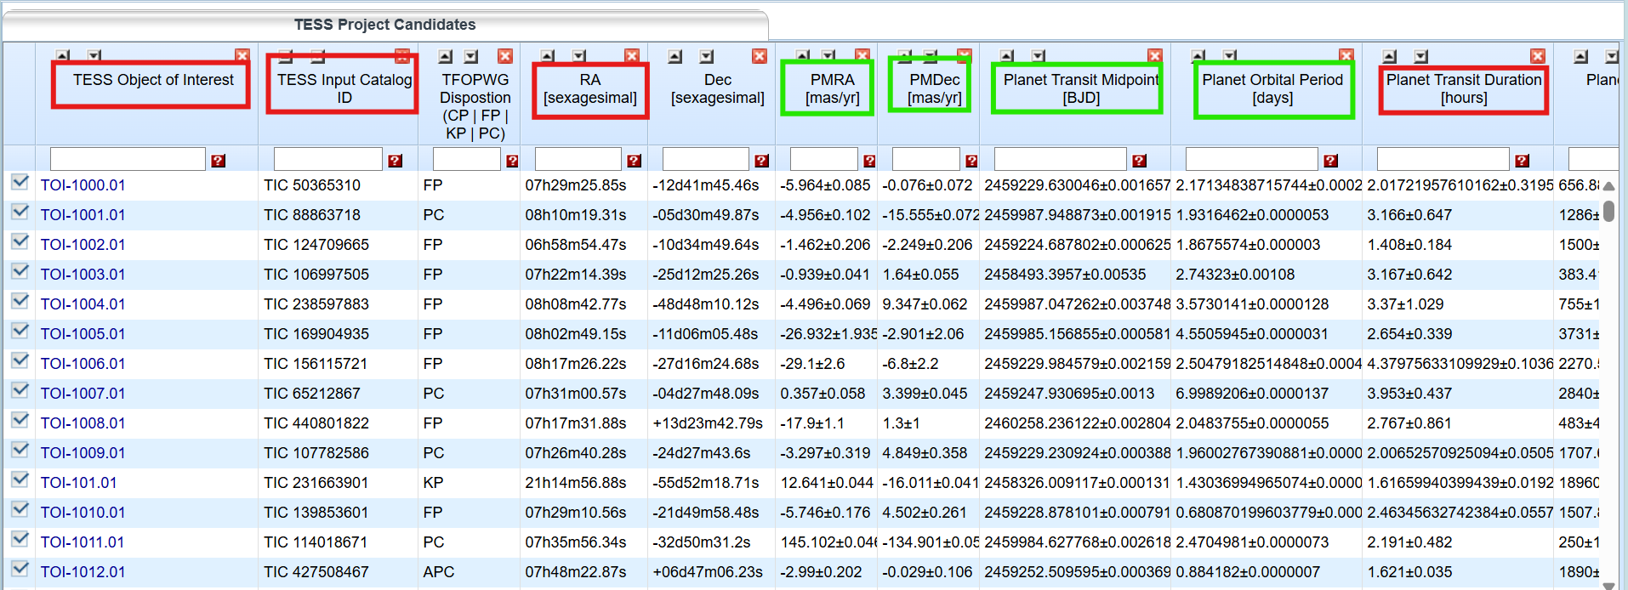

Data Cleaning & Preprocessing
Kepler Objects of Interest (KOI)
Null Handling: Replace missing values with median.
Scaling: Use RobustScaler to normalize features. (Highlighted in Green)
Categorical Encoding: Convert categorical columns to numerical codes.
Feature Selection: Drop irrelevant or redundant columns. (Highlighted in Red)
TESS Objects of Interest (TOI)

Slide 7
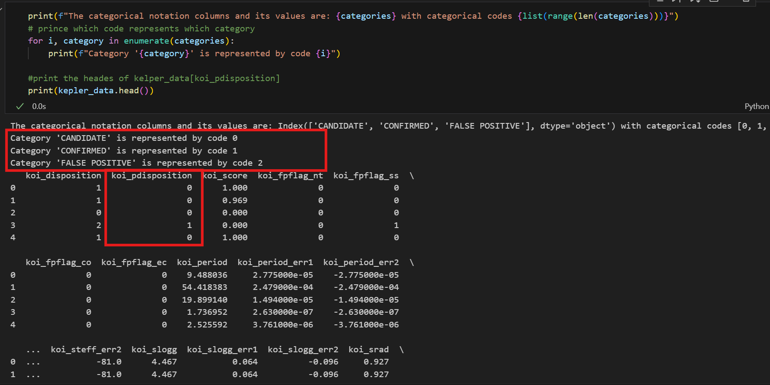
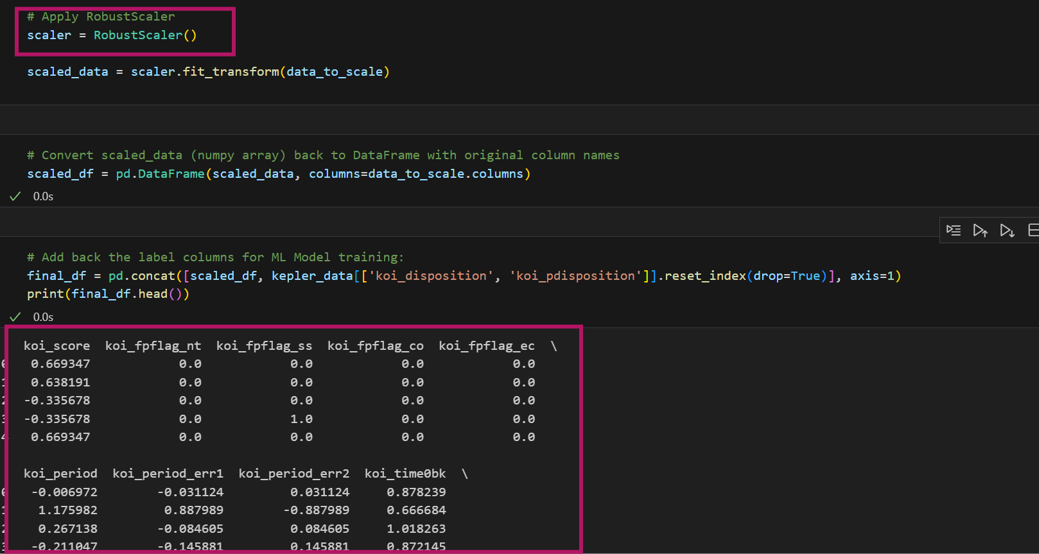
Categorical Encoding…..
'CANDIDATE’ → 0
'CONFIRMED’ → 1
'FALSE POSITIVE’ → 2
…..RobustScaler to normalize features

Slide 8
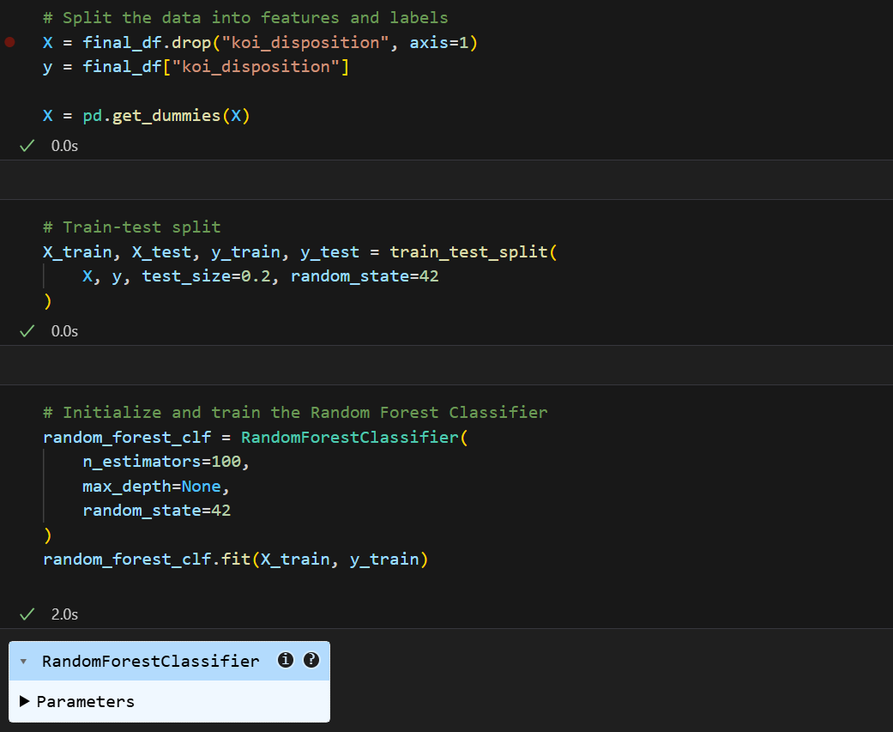
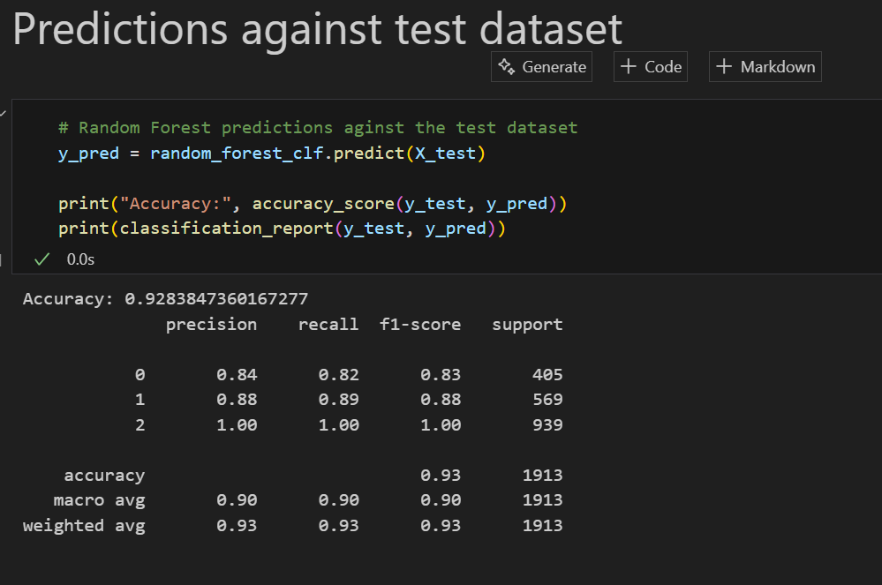

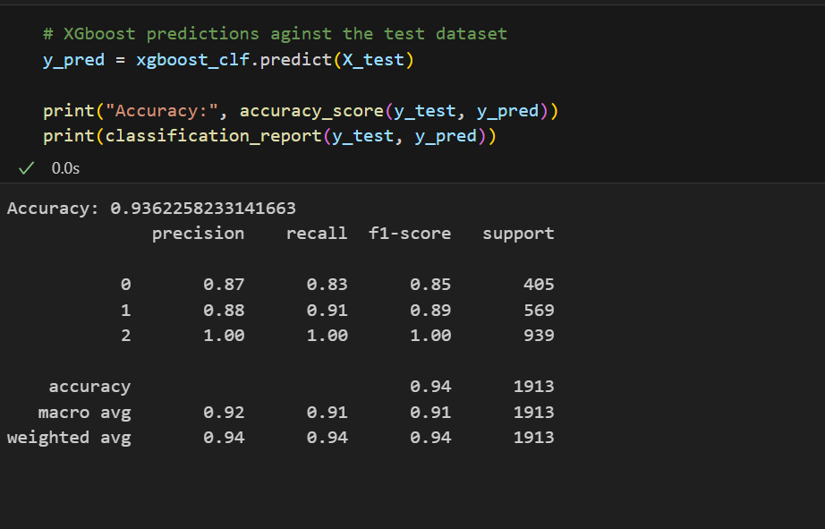
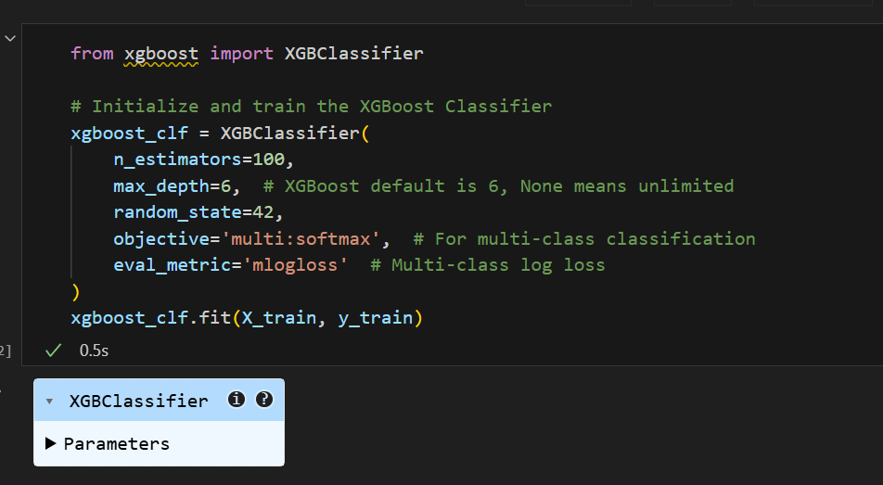
Machine Learning Approach's
Random Forest
Train
Test
XGBoost

Slide 9



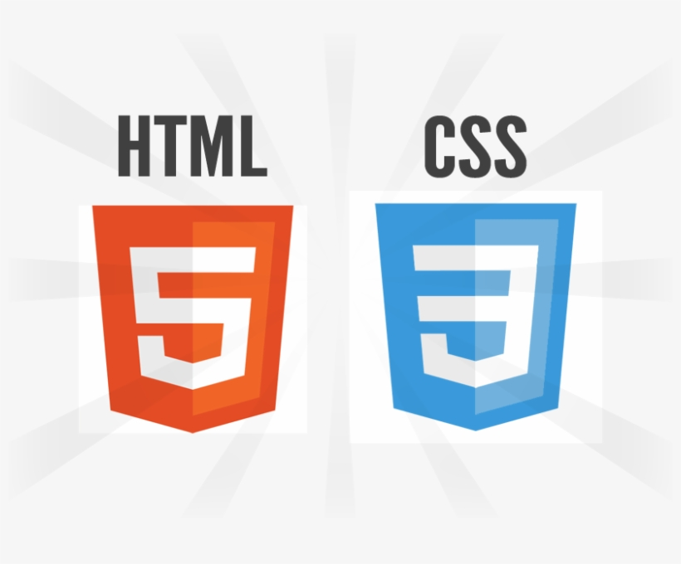
DeepSky Divers
Enhancing your
presentation
DEMO..!!
https://deepskydivers.us

Slide 10
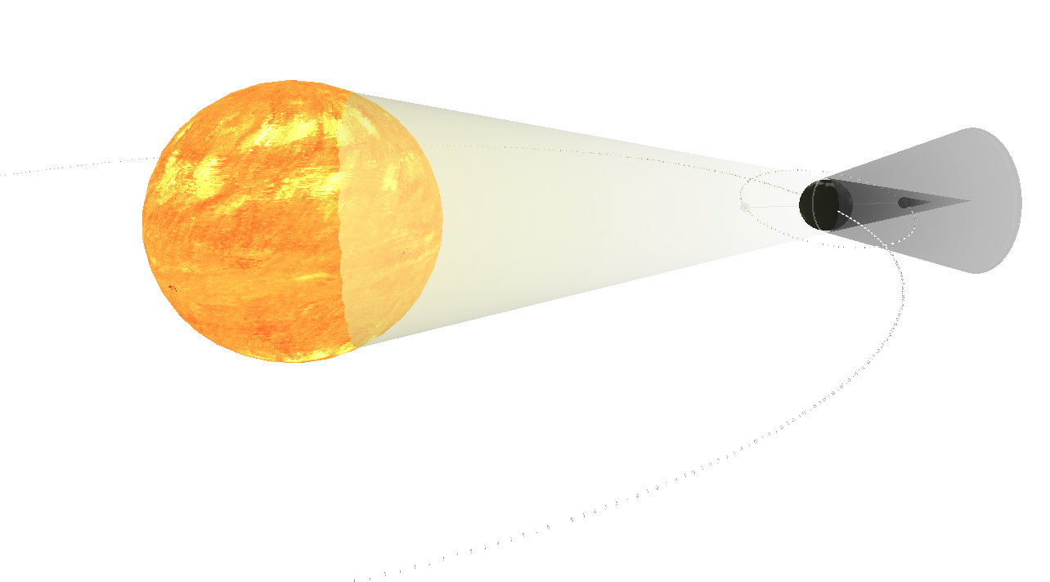
Challenges
Handling Scaling datasets and missing values.
Ensuring consistent preprocessing for training and prediction.
Dealing with imbalanced classes.
Integrating frontend and backend smoothly.

Slide 11
References
Handling Scaling datasets and missing values.
Ensuring consistent preprocessing for training and prediction.
Dealing with imbalanced classes.
Integrating frontend and backend smoothly.

Slide 12

Future Goals:
Your ability to communicate effectively will leave a lasting impact on your audience
Effectively communicating involves not only delivering a message but also resonating with the experiences, values, and emotions of those listening

Slide 13
Thank you
Any Questions ??
sanjana.vishwanatha2000@gmail.com
nagarjunts008@gmail.com

